Slide 1
Programming for Persistent Memory in Golang
Pratap Subrahmanyam, Fellow, VMware, Inc.
pratap@vmware.com
July 22, 2019

Slide 2
Goals
A quick introduction to persistent memory
  What is it? Who is building it? When will it be available? What use cases are enabled? Cost/Performance. Etc.
Describe current status
  The impact we have made so far
Lessons learned
  Mistakes made (and avoided!)
Call for action, how can VMware help?

Slide 3
Introducing Persistent Memory
Same form factor as a traditional DIMM
3X the endurance of NAND
Much higher densities:
  4X the capacity of DRAM
  256GB – 2TB per DIMM
Read latency is comparable to RAM, write latency is 3 – 5x slower than RAM
Can be used in non-persistent mode, as high density, slower RAM.
Cost: closer to DRAM
When it is available:
  Now
  Build your favorite Dell server with persistent memory installed

Slide 4
Use Cases
Density - Augment fast, low density DRAM with
  slower, high density 3DXpoint in non-persistent mode
  Large graph processing applications
  Avoid the management ugliness of scale out
Tiered Storage - Augment SSDs with
  expensive, low latency storage
Persistence with Random Access - Use the load/store model
  Large in-memory databases
    SAP HANA, Redis, SQL …
  Large AI models
    Starting to appear in accelerator boards

Slide 5
What we did …
First things first
  Virtualized Persistent Memory
  Zero day hardware support
Avoided the ramp-up items, chose the hardest one to explore
  The load/store model
3 Questions
  After all the logging, write amplification, cache flushes for crash consistency, is there still performance to be gained?
  Is the code readable?
    Programming with Persistent Memory
    Identifying transactions
  Coping with crash consistency, durability, availability

Slide 6
Pass #1: C based
Wrote a transaction library
  Built-in replication into transaction library
Chose to modify Redis (open source, C based application)

Slide 7
Performance Results

Slide 8
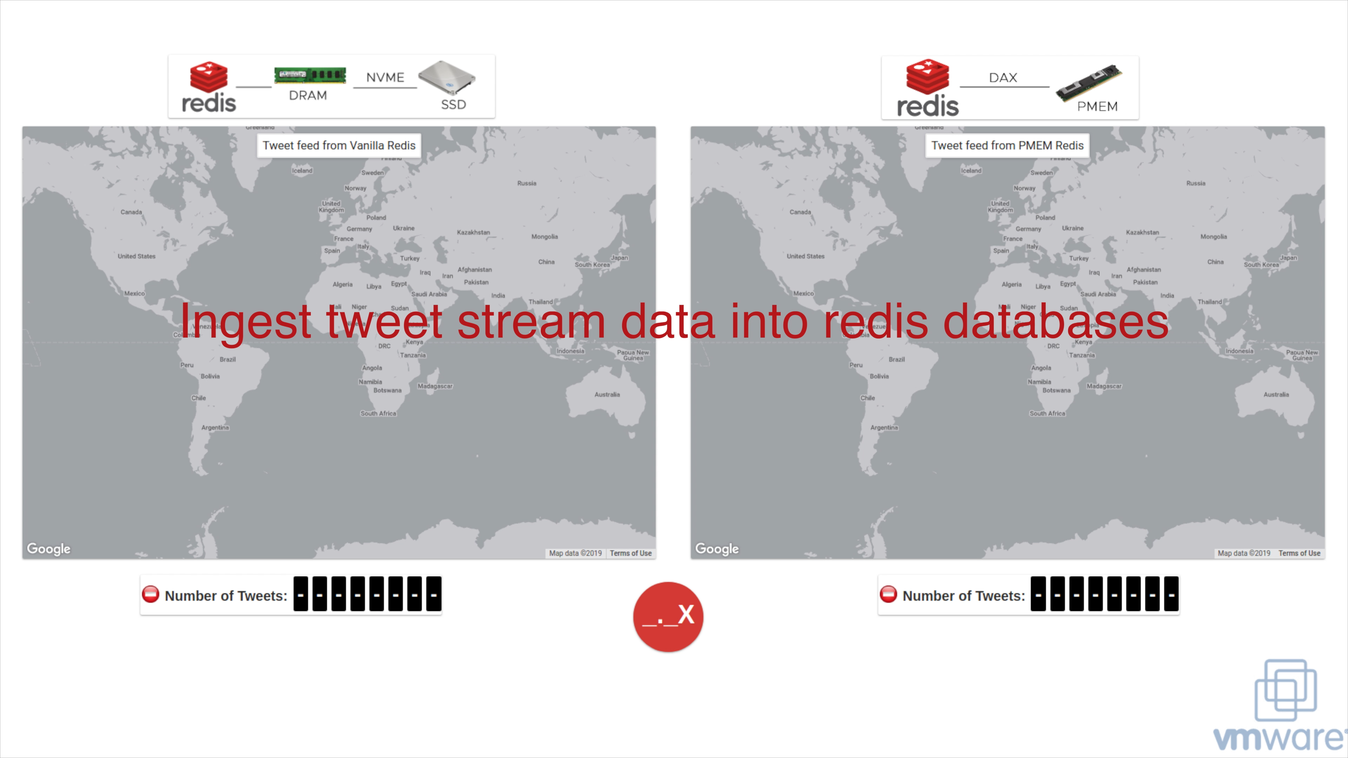
Motivation
Notes:
Advantages of persistent memory
SSD load time increases with increasing data sie

Slide 9
Conclusion:
Performance improvements are real …
What about code maintainabilty?

Slide 10
Intel PMDK library
// Adds a node to the linked list and updates the tail (and head)
void addNode() {
  TOID(struct root) r = POBJ_ROOT(pop, struct root);
  TOID(struct entry) e;
  struct root *rp = D_RW(r);
  struct entry *tp = D_RW(rp->tail);
  TX_BEGIN(pop) {
e = TX_NEW(struct entry);
TX_ADD_DIRECT(rp);
D_RW(e)->id = rand();
D_RW(e)->next = TOID_NULL(struct entry);
if (TOID_IS_NULL(rp->head)) {
rp->head = e;
} else {
TX_ADD_DIRECT(&tp->next);
tp->next = e;
}
rp->tail = e;
  } TX_ONABORT {
    abort();
  } TX_END
}
struct root { // The root object
TOID(struct entry) head;
TOID(struct entry) tail;
};
// Structure of each node in the linked list
struct entry {
int id;
TOID(struct entry) next;
};

Slide 11
Summary …
Very intrusive code changes
Source code has become harder to read
Fragility!
  Crash consistency, missed logging etc.

Slide 12
Conclusion:
Cannot guide our customers to use the load/store model & port their applications to persistent memory machines!

Slide 13
Main Irritants
The logging code
The restart from crash path needs to be streamlined
Code to mark the beginning and end of transactions

Slide 14
Our Goal …
// Adds a node to the linked list and updates the tail (and head)
func addNode(tx transaction.TX, rptr *root) {
  entry := new(entry)
  entry.id = rand.Intn(100)
  if rptr.head == nil {
rptr.head = entry
  } else {
rptr.tail.next = entry
  }
  rptr.tail = entry
}
// Adds a node to the linked list and updates the tail (and head)
func addNode(tx transaction.TX, rptr *root) {
  txn {
  entry := pnew(entry)
  entry.id = rand.Intn(100)
  if rptr.head == nil {
rptr.head = entry
  } else {
rptr.tail.next = entry
  }
  rptr.tail = entry
  }
}
// The root object
type root struct {
  head *entry
  tail *entry
}
// Structure of each node in the linked
// list
type entry struct {
  id int
  next *entry
}

Slide 15
Pass #2: Golang
Why Golang?
  100% open source, vibrant community
  Good systems language
User:
  Identify the variables that need to be in persistent memory
  Allocate them on the Golang heap
  Mark the transaction’s begin/end
Compiler:
  Extends language with txn { … }, and pnew(…)
  Automatically generates logging code.
Runtime:
  Full garbage collection
  Named heap objects

Slide 16
Code Changes
Heap changes:
  src/runtime: 44 files changed, 2434 insertions(+), 196 deletions(-)
  src/reflect: 3 files changed, 76 insertions(+), 30 deletions(-)
  src/go: 4 files changed, 66 insertions(+), 52 deletions(-)
  src/cmd/compile/internal/gc: 12 files changed, 99 insertions(+), 28 deletions(-)
  Total: 63 files changed, 2675 insertions(+), 306 deletions(-)
  (excluding design/README documents and CPUID package

Slide 17
Code Changes
Compiler changes for transaction instrumentation:
  src/cmd/compile/internal/gc: 7 files changed, 488 insertions(+), 26 deletions(-)
  src/cmd/compile/internal/syntax: 6 files changed, 132 insertions(+), 13 deletions(-)
  src/cmd/compile/internal/ssa/: 1 file changed, 3 insertions(+)
  src/cmd/go/internal: 3 files changed, 7 insertions(+)
  Total: 17 files changed, 630 insertions(+), 39 deletions(-)

Slide 18
Repositories
Runtime changes to support persistent heaps: https://github.com/jerrinsg/go-pmem
Libraries for transactions support, logging: https://github.com/vmware/go-pmem-transaction
A partial Redis rewritten in Go: https://github.com/vmware-samples/go-redis-pmem

Slide 19
Performance Data

Slide 20
Conclusion:
You can get the performance, without introducing fragility into the code! You just need language support!
Plans for Java, C++, Rust, Python, R?
We have built up a great deal of expertise, best practices.
Cautiously starting customer conversations to port applications.

Slide 21
Lessons Learned
What we did right
  Think small! First things first, and all that.
  Virtualizing pmem was the right thing, brought lots of mindshare with ecosystem
  Simplifying the programming of persistent memory
What we didn’t do right
  Got distracted with new proposal: battery backed DIMM.
  Diluted our efficiency somewhat.

Slide 22
What’s next?
Encourage all BU’s to run their services on machines with persistent memory
  We have a great deal of expertise now, we can help
  Moreover, there is some real value (performance, simplicity ...) to be gained here
Assist partners/customers with the migration to persistent memory
Improve compiler & transaction library
Explore the ”density” dimension of persistent memory

Slide 23
Summary
You can buy machines from Dell with persistent memory
There is REAL performance to be gained!
Golang has gained native persistent memory support!
VMware has developed deep expertise in persistent memory programming
  Can help others migrate their applications.

